Slide 1
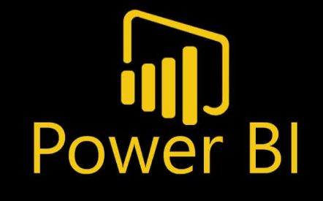
Introduction to Microsoft Power BI
By Saniya Malkan Ahmed
On 20^{h} June 2025
Notes:
Hello everyone!
Welcome to this short but powerful session on Power BI – Microsoft’s tool for data analysis and visualization.
In just 15 minutes, I’ll give you a quick overview, show you how it works, and even guide you through a short hands-on demo.

Slide 2



Saniya Malkan Ahmed
Technical Instructor – Data & AI http://www.linkedin.com/in/saniya-malkan-ahmed
Bachelor’s degree in Computer Science & Engineering
Master’s degree in Data Science & Computational Intelligence
Trained and mentored hundreds of people into a data analytics career
“Tell me and I forget. Teach me and I remember. Involve me and I understand —especially with data."
— Inspired by Benjamin Franklin
Notes:
Self Intro

Slide 3
Agenda
Introduction to Power BI and its key features
Power BI Interface
Importing a Dataset
Create a mini dashboard
Knowledge Check
Recap & Q&A
Notes:
Here’s our agenda for today:
We’ll start with a quick intro to what Power BI is,
explore its interface, load datasets
look at some real-world examples,
then jump into a live demo where we’ll build a mini dashboard.
We’ll finish with a quick knowledge check and a recap.

Slide 4
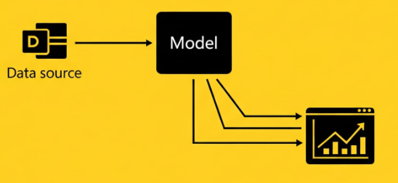
What is Power BI?
A Microsoft Business Intelligence (BI) tool.
Helps transform raw data into interactive dashboards & reports.
Connects to various data sources (Excel, SQL, Web, etc.)
Used by analysts, business users, and decision-makers worldwide.
Notes:
Power BI is a business analytics tool developed by Microsoft.
It helps you turn raw data into meaningful insights through visual dashboards and interactive reports.
You can connect to a variety of data sources like Excel, SQL databases, SharePoint, and even cloud services like Salesforce and Google Analytics.
Once the data is loaded, Power BI lets you clean it, model it, and visualize it in many different ways.
And the best part? It’s designed for everyone from analysts to decision-makers.

Slide 5
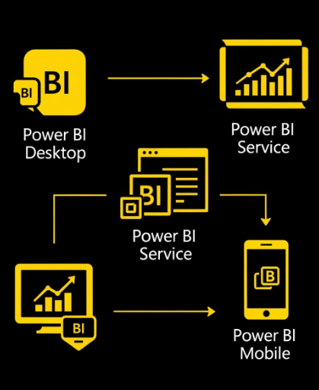
Power BI Ecosystem
Power BI Desktop
Power BI Service
Power BI Mobile
Notes:
Power BI is made up of several key components: But these are the 3 main components
Power BI Desktop – This is your main tool to create and design reports. It’s free and very user-friendly.
Power BI Service – This is the online platform where you publish and share reports with your team.
Power BI Mobile – For viewing reports on your phone or tablet.

Slide 6
Power BI Desktop Demonstration
Notes:
Start sharing screen in Power BI Desktop
“First, we load our data.”
(Click on “Get Data” > Excel > Select file)
“I’m using a simple sales dataset with columns like Region, Product, Sales Amount, and Date.”
“Next, let’s create a bar chart.”
(Drag Region into Axis, Sales into Values)
“This shows total sales by region.”
“Let’s add a card to display total sales.”
(Card visualization, drop Sales field)
“Now, we’ll add a slicer so we can filter by Region.”
(Slicer visualization with Region field)
“And that’s it — in just a couple of minutes, we’ve built an interactive report.”

Slide 7




Real-World Use Cases
HR Analytics: Visualize hiring & attrition data
Finance Reports: Monitor KPIs like revenue, cost.
Manufacturing Quality Control: Identify defect rates & machine downtime
Sales Dashboard: Track regional performance.
Notes:
Power BI is used in a wide range of industries and departments.
For example, a sales team might use it to track regional performance across time.
The finance department can monitor KPIs like revenue, profit margins, and expenses.
Even HR teams use it to visualize hiring trends, retention rates, and employee engagement.
If your team deals with data — Power BI can help make it clearer and more actionable

Slide 8

Knowledge Check
What tool is used to create Power BI reports?
A) Excel
B) Power BI Desktop
C) PowerPoint
Which component is used to share reports online?
A) Power BI Desktop
B) Power BI Service
C) Power Query

Slide 9
Recap
Power BI helps turn your data into insights
It includes tools like Power BI Desktop, Service, and Mobile.
You can build and share dashboards quickly and easily.
It’s useful across all business functions.
Notes:
It’s useful across all business functions.

Slide 10


THANK YOU!
Any Questions?
Saniya Malkan Ahmed

